Slide 1
RDBMS IA 1 Name: Pranav Patki Roll No: 1911038 Batch: A3

Slide 2
Research Paper - BASIC NOSQL INJECTION ANALYSIS AND DETECTION ON MONGODB Published by: Vrinda Sachdeva & Sachin Gupta

Slide 3
Introduction
In recent years, the usage of Information technology has unexpectedly increased resulting in huge data generation.
Many companies have taken initiative to use non relational database for managing the data.
It has powerful function to manage big data.
Huge amount of data has been generated every day.
It possibly results in malicious information into the database.
No SQL database gaining popularity due to its powerful features like scalability, flexibility, faster data access and availability.
In this paper, we will analyze the injection on NOSQL database .

Slide 4
What is NO SQL injection?
NoSQL injection vulnerabilities allow attackers to inject code into commands for databases that don’t use SQL queries, such as MongoDB.
NoSQL injection attacks can be especially dangerous because code is injected and executed on the server in the language of the web application, potentially allowing arbitrary code execution.

Slide 5

How is injection implemented in NOSQL databases
NOSQL database provide looser consistency restrictions than relational database.
NOSQL database offer performance advantage, horizontal scaling and partition tolerance benefits.
Mostly NOSQL injection attacks tries to inject code at the input box.
So, the solution is to sanitize the input before using it.

Slide 6
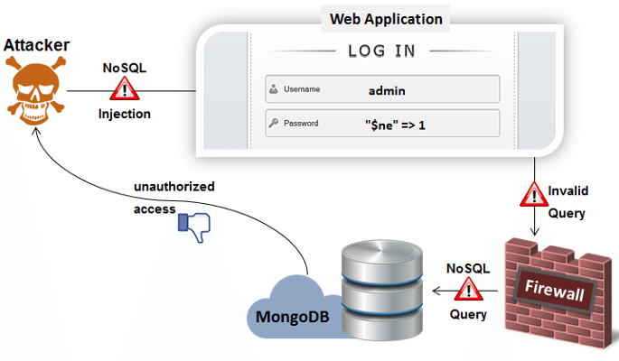
How is injection implemented in NOSQL databases
Hackers try to inject malicious code either into input box or URL using GET or POST method.
It can be injected by using PHP and Java script code.
Input box are generally used in query which means that parameter of input method are used to store the value and participate in execution.

Slide 7
Example of injection
.The detection of nosql injection can be understood through an example demonstrating the various nosql injection attack classification.
Injection occurs on database by inputting a malicious code into the input box.
By using this malicious code hackers gets user authority and obtain information from the database.
Program starts to search on the basis of user input .
When malicious code is executed then it always bring true results.
As a result, hackers will get all data without passing input.

Slide 8
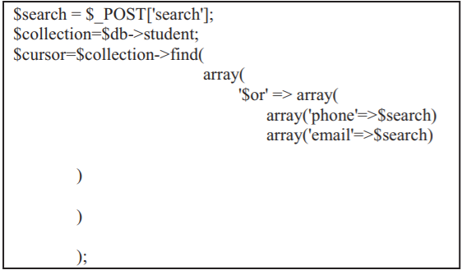
Example of injection
Consider, there is a student database in MongoDB which stores all the student data such as name, college _name, email _id, phone _no, location etc.
Users search the student information by inputting email _id or phone _no in input box.
If the email _id or phone _no is matched, the system will display the details of student.

Slide 9
Example of injection
In this case, the system gets the value from input box by $post [‘search’] and then send it to a search variable.
After that the value of database will be store in collection variable.
The system starts to query by email _ id or phone _ no and the matched value will be stored in cursor variable.
Then it start to search document wise and output the student details.

Slide 10
Example of injection
It means student information displayed only when the results of the find () function is true.
Thus the hackers enter malicious query in order to true its statement.
Lets suppose that the hacker simply added a != operator inside the phone number segment of code.
Now, the results of find () function will always be true and so it will display all the data except where phone _ no =12345.
The system now searches the student Information.

Slide 11
How does this happen?
Hackers cannot apply != operator directly on our system.
They execute this on some web Penetration testing framework.
When used as a proxy server it allow the user to manipulate all of the traffic that passes through it, including traffic using https.

Slide 12
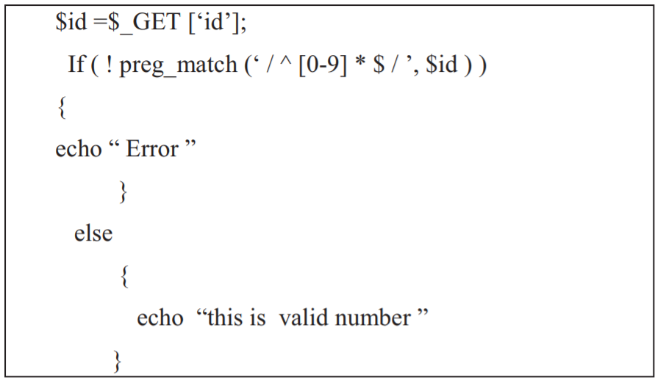
MONGODB NOSQL DEFENSE ANALYSIS
1) Input validation: which means to limit user input.
As for phone no. query, all characters should be numbers.
While writing the code, developer can add some constraint in code to limit the input box so that it can accept only number in phone no.
Since notations are used in malicious code, so this method is used to prevent all unwanted characters.
By using this solution, we can check the input before it is passed to variable .

Slide 13
MONGODB NOSQL DEFENSE ANALYSIS
2) Parameterized statement to check and filter the variable for a query.
While writing condition statement, variable cannot be directly embedded into the condition statement.
However, we can use parameterized statement to pass variables for the user input.
Parameterized statement uses parameter rather than embedding user input variable into the query.
Using this method, we can remove most of injection attack

Slide 14
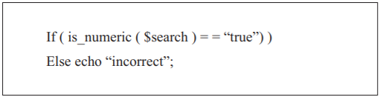
MONGODB NOSQL DEFENSE ANALYSIS
For example there is some code to find the character in a variable if it contains number only or not, by checking the phone no .
If yes, then it will pass the value otherwise reject.

Slide 15
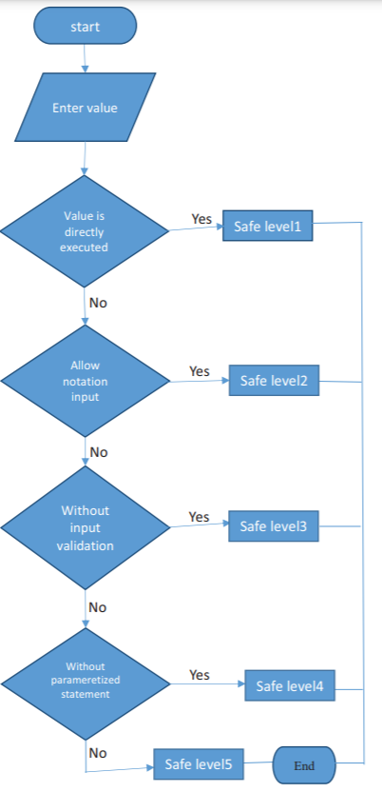
Layers of safety

Slide 16
Conclusion
Information security plays the most important role in system.
While writing code, developer should apply defense method to make a secure system.
By applying defense method, the developer can prevent from injection or any other attack.

Slide 17
Implementation
Normal login requests will be shown and how they can get dangerous if not implemented using the safety layer standards mentioned in the paper.
Planning on displaying techniques used to avoid such code and write it in a way it is more safe and clean to understand and execute.

Slide 18
Bibliography
https://ieeexplore.ieee.org/document/8933707
https://www.netsparker.com/blog/web-security/what-is-nosql-injection/
https://medium.com/rangeforce/nosql-injection-6514a8db29e3

Slide 19
THANK YOU!!

